Slide 1
AE Cloud2 Arduino Digilent GPS UART Header
By Michael Li 4/3/2019

Slide 2
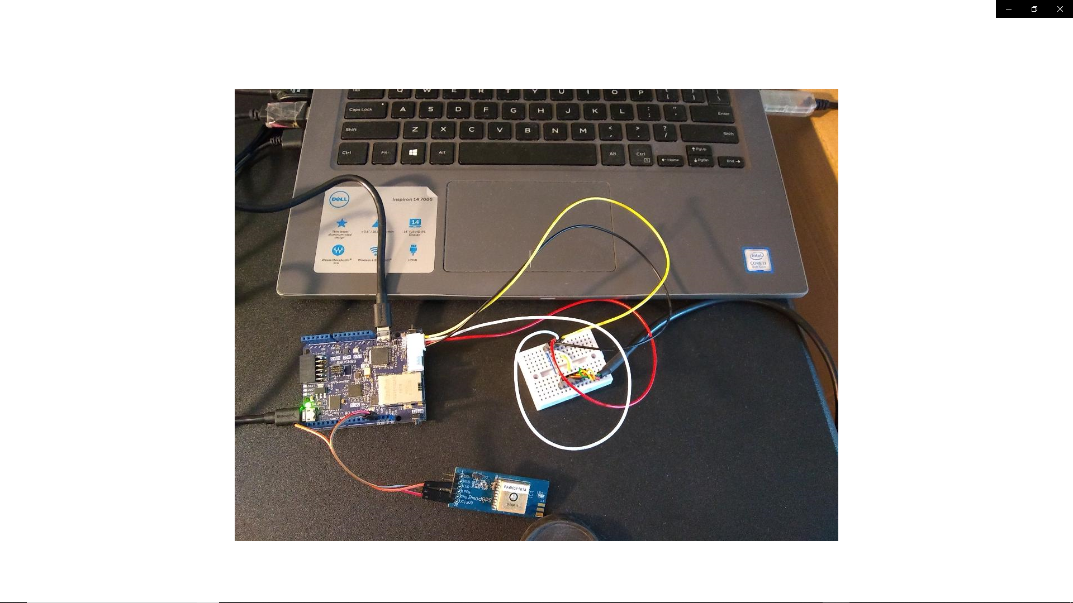
Serial 1 (Grove Header): UART to USB converter Serial 0 (Arduino Header) : GPS sensor

Slide 3
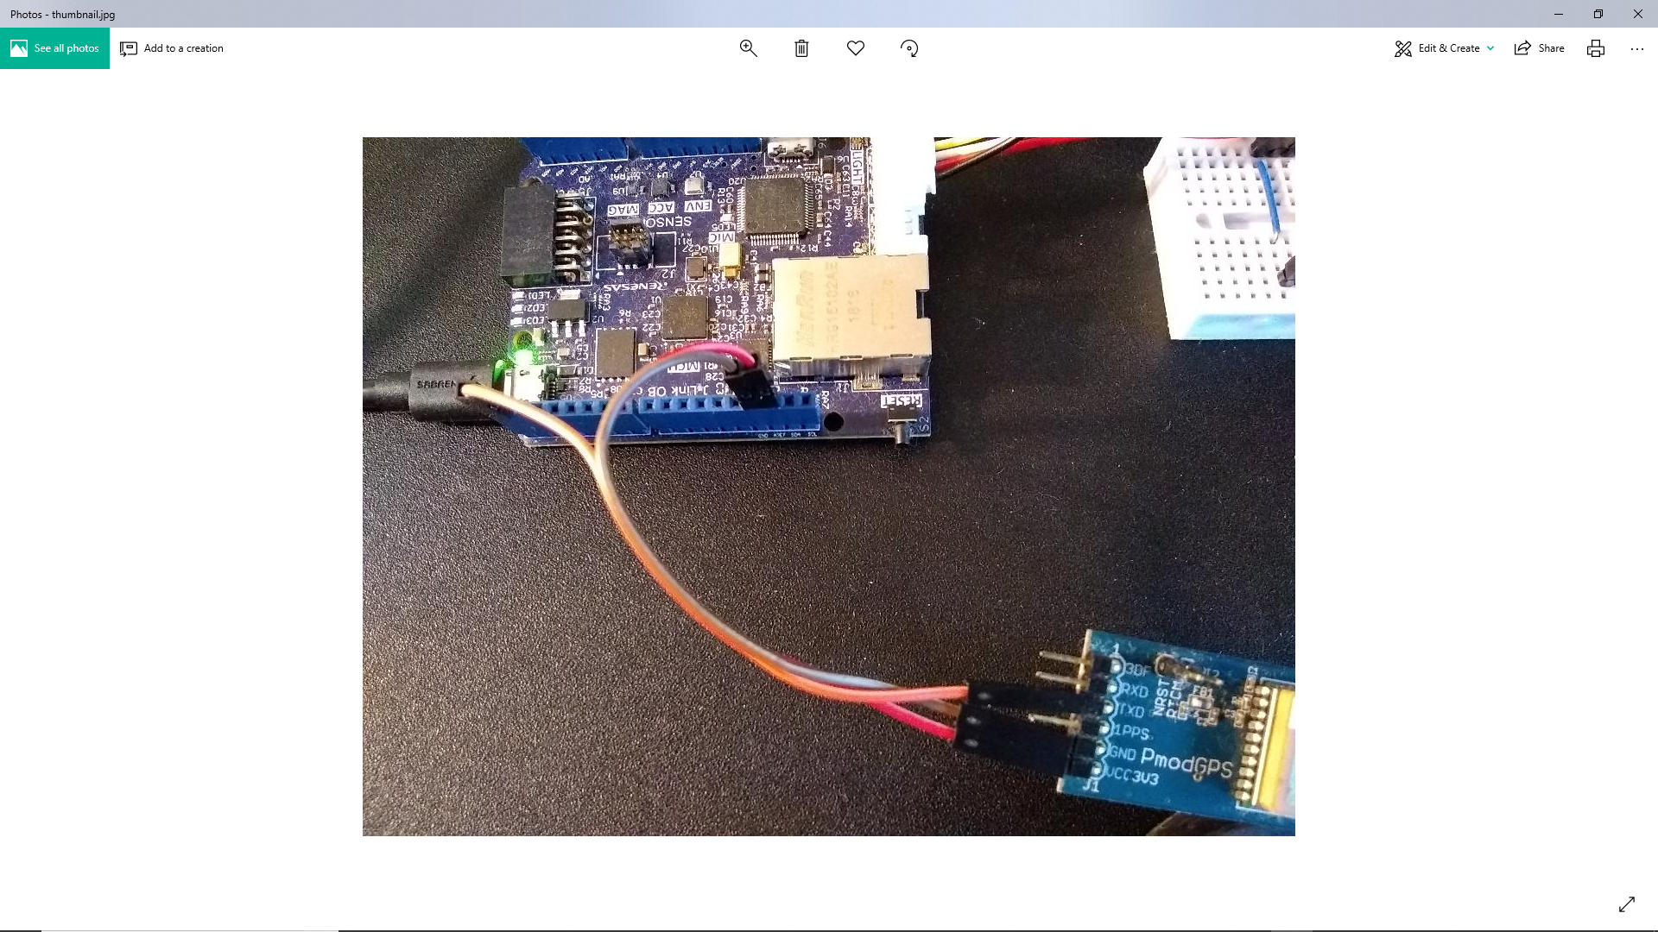
Serial 0 RX (D1) to TX (GPS sensor – orange wire) AVREF or 3.3V to 3.3V (GPS sensor – red wire) GND to GND (GPS sensor – brown wire)

Slide 4
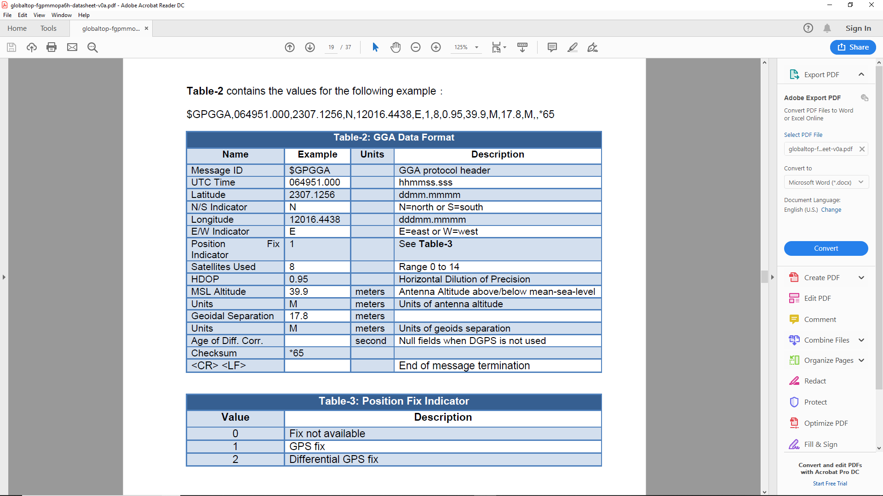
Data Packet Format

Slide 5
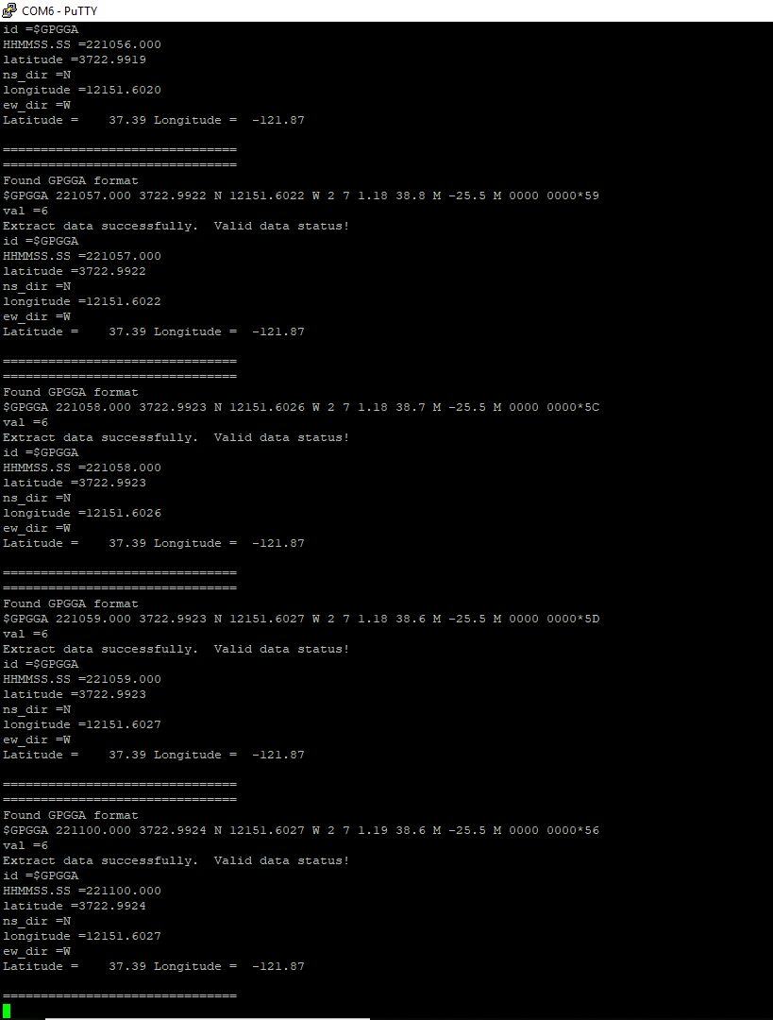
GPGGA protocol with checksum verified.
===============================
Found GPGGA format
$GPGGA 221058.000 3722.9923 N 12151.6026 W 2 7 1.18 38.7 M -25.5 M 0000 0000*5C
val =6
Extract data successfully. Valid data status!
id =$GPGGA
HHMMSS.SS =221058.000
latitude =3722.9923
ns_dir =N
longitude =12151.6026
ew_dir =W
Latitude = 37.39 Longitude = -121.87

Slide 6
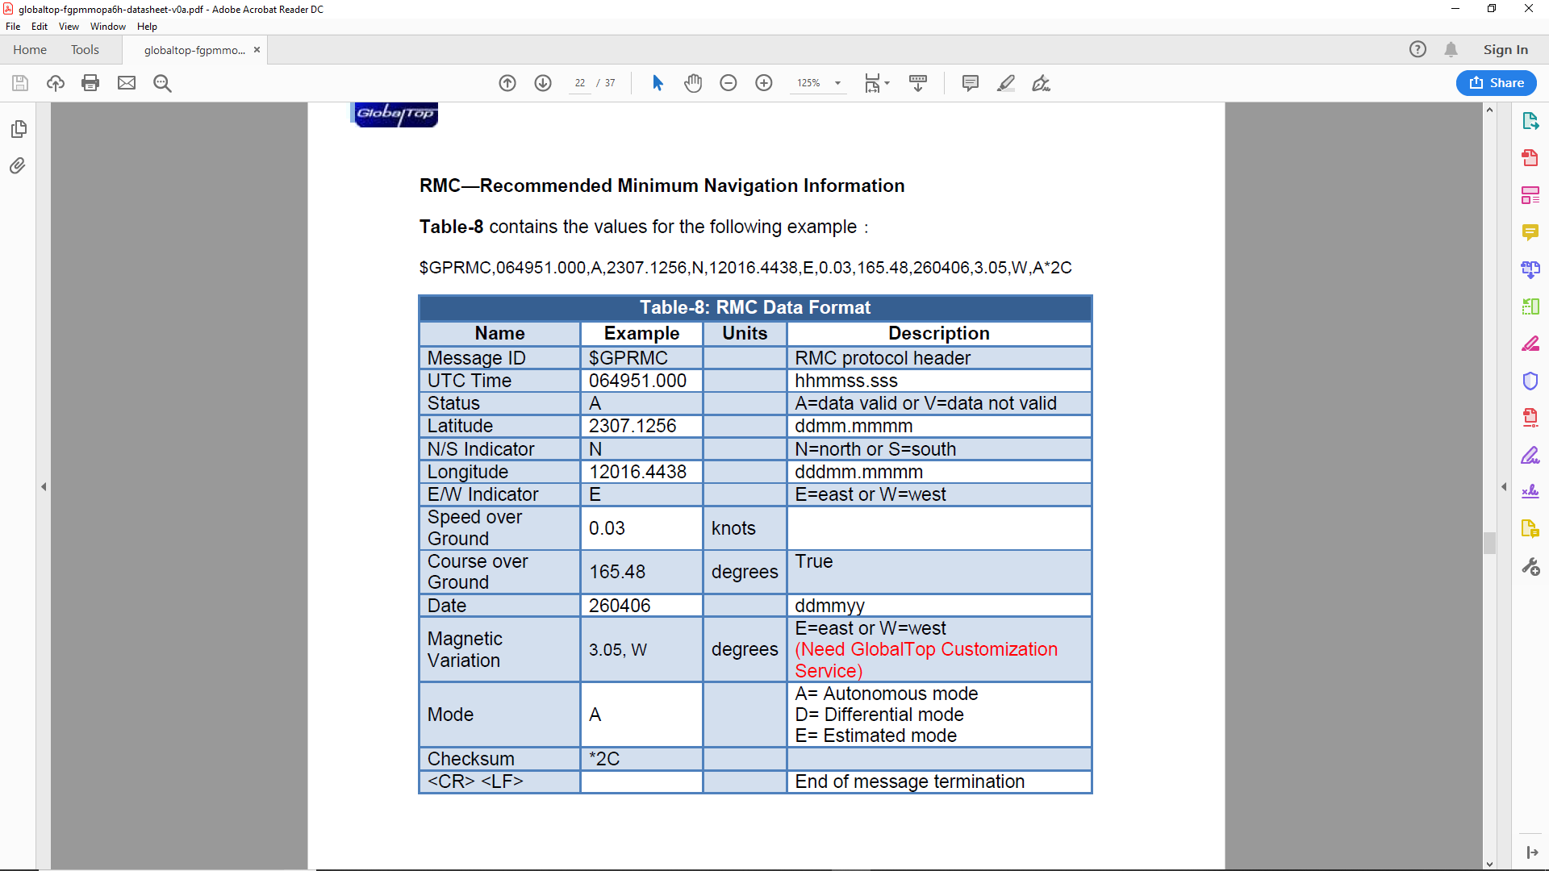
Data Packet Format

Slide 7
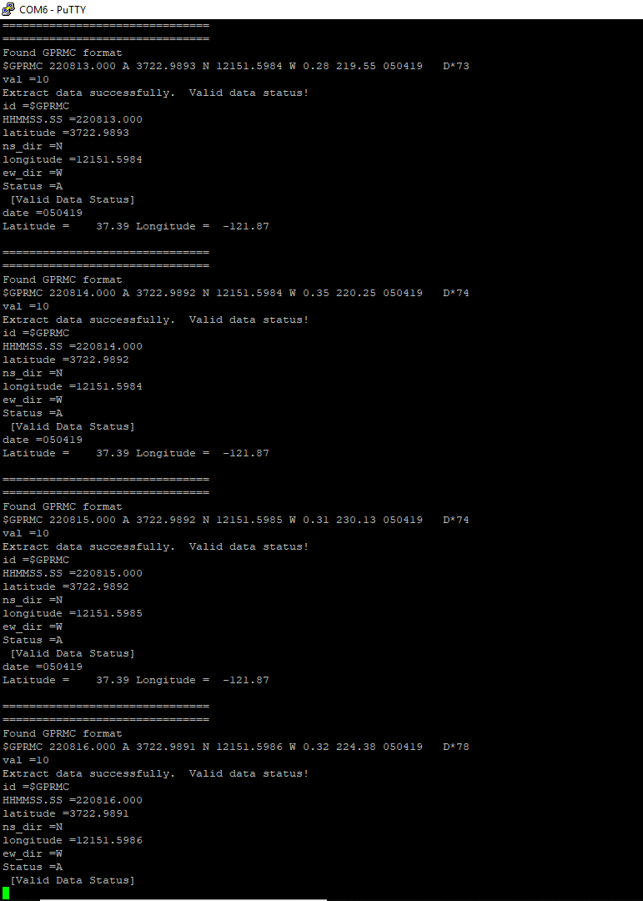
GPRMC protocol with checksum verified.
===============================
Found GPRMC format
$GPRMC 220859.000 A 3722.9907 N 12151.6017 W 0.23 317.50 050419 D*70
val =10
Extract data successfully. Valid data status!
id =$GPRMC
HHMMSS.SS =220859.000
latitude =3722.9907
ns_dir =N
longitude =12151.6017
ew_dir =W
Status =A
[Valid Data Status]
date =050419
Latitude = 37.39 Longitude = -121.87

Slide 8
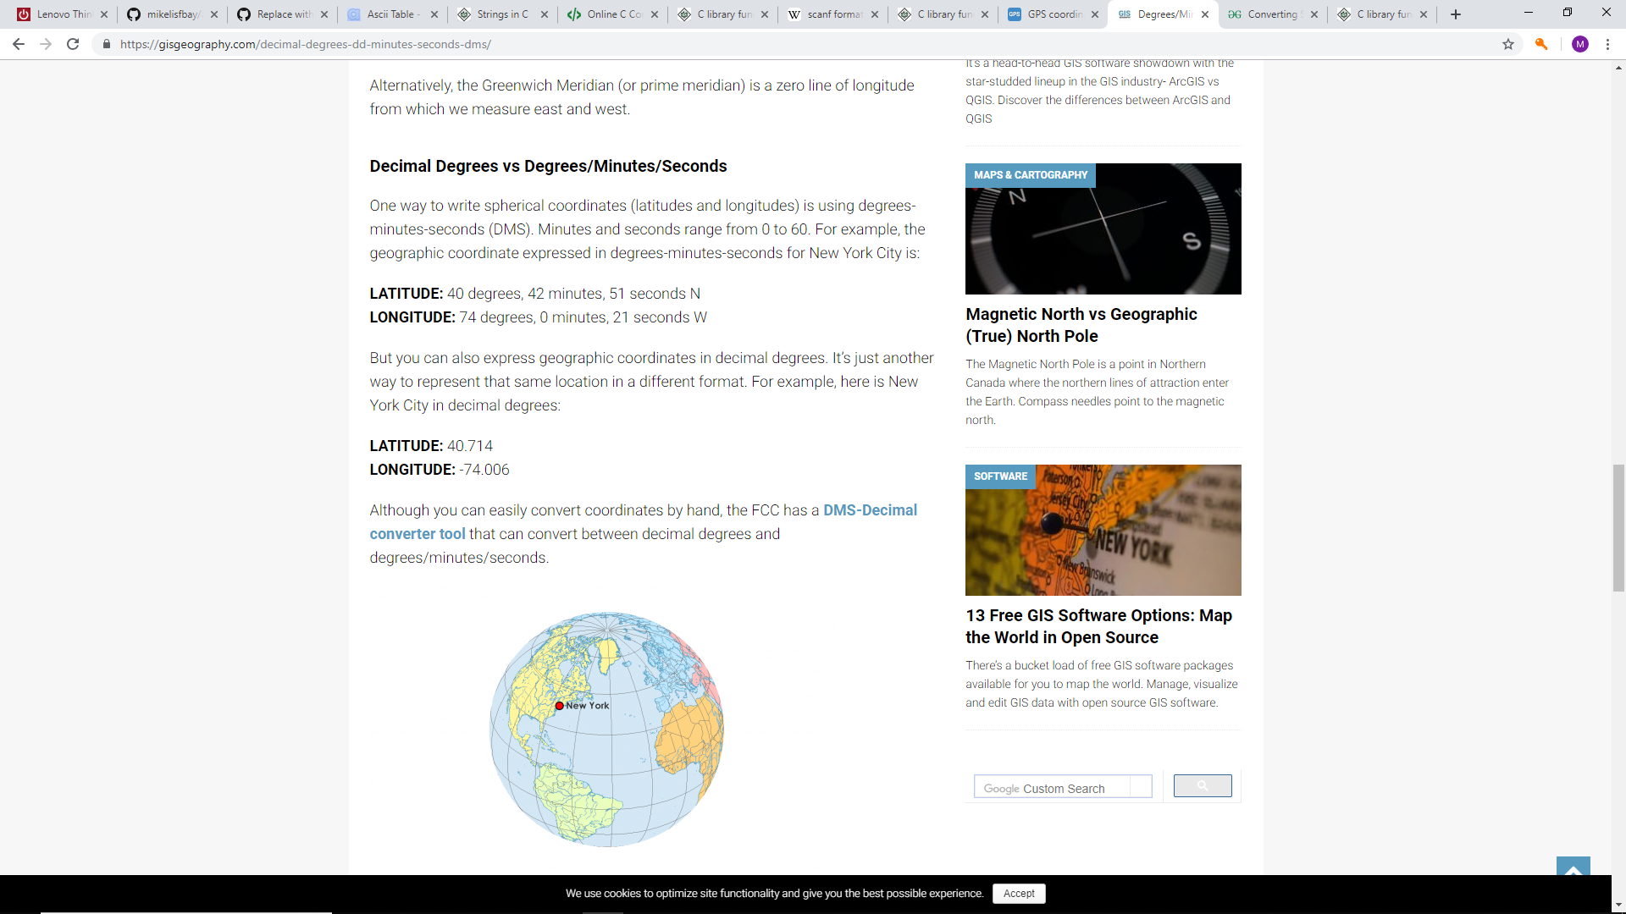
Conversion (DDMMSS to Decimal degree) Latitude: DDMM.SSSS N/S → DD+MM/60+ SS/3600 (South: negative number) Longitude: DDDMM.SSSS E/W → DDD+MM/60+ SS/3600 (West: negative number)

